Slide 1

Go Track
PowerUp! SG Tech Traineeship – Software Engineering

Slide 2
Important Notes
The course shall be conducted in the following format
Face to Face sessions
Online sessions
Participants are expected to be involved in
Session discussions
Online automated assessment submission

Slide 3
Learning Objectives – Mod 1
At the end of the course, participants should be able to:
Examine how Go was conceived.
Setup various required development environments and platform necessary to prepare for Go development.
Identify the needs of a proper Software Version Control.
Define the basic processes of using Git and integrated plugin.
Demonstrate a simple Git and online submission process.

Slide 4
Introduction to Go
Internal Google project in 2007.
Original design
Robert Griesemer
Rob Pike
Ken Thompson.
Uses open development model.
Launched officially 2009

Slide 5
Comments to Go
Some comments to return to at the end of the course.
‘Complexity is Multiplicative…’
- Rob Pike, Google
Fast execution
VS
Rapid development
No languages make good use of multi-core CPUs
‘Clumsy type systems drive people to dynamically typed languages.’
- Robert Griesemer, Google
Make Programming fun again!
Performance, go fast!

Slide 6
Why Go?
Clear, concise syntax
Strongly typed language, but simpler type system
Cross platform
Garbage collection
Explicit dependences for faster build

Slide 7
Drawback of Go?
No classes, no type inheritance, no op overloading, no generics
NOTE: Generics are available Version 1.18 onwards, advised to use at own risk. Not fully developed.
Relatively young so library and supports are limited.
Effort needed to interface with 3rd party programs.
No user interface for development and very command prompt based.
Error handling is basic. Can be repetitive.

Slide 8

Setting up Go
Go
Primary software of interest
Open-source programming language
Download is available – https://go.dev

Slide 9
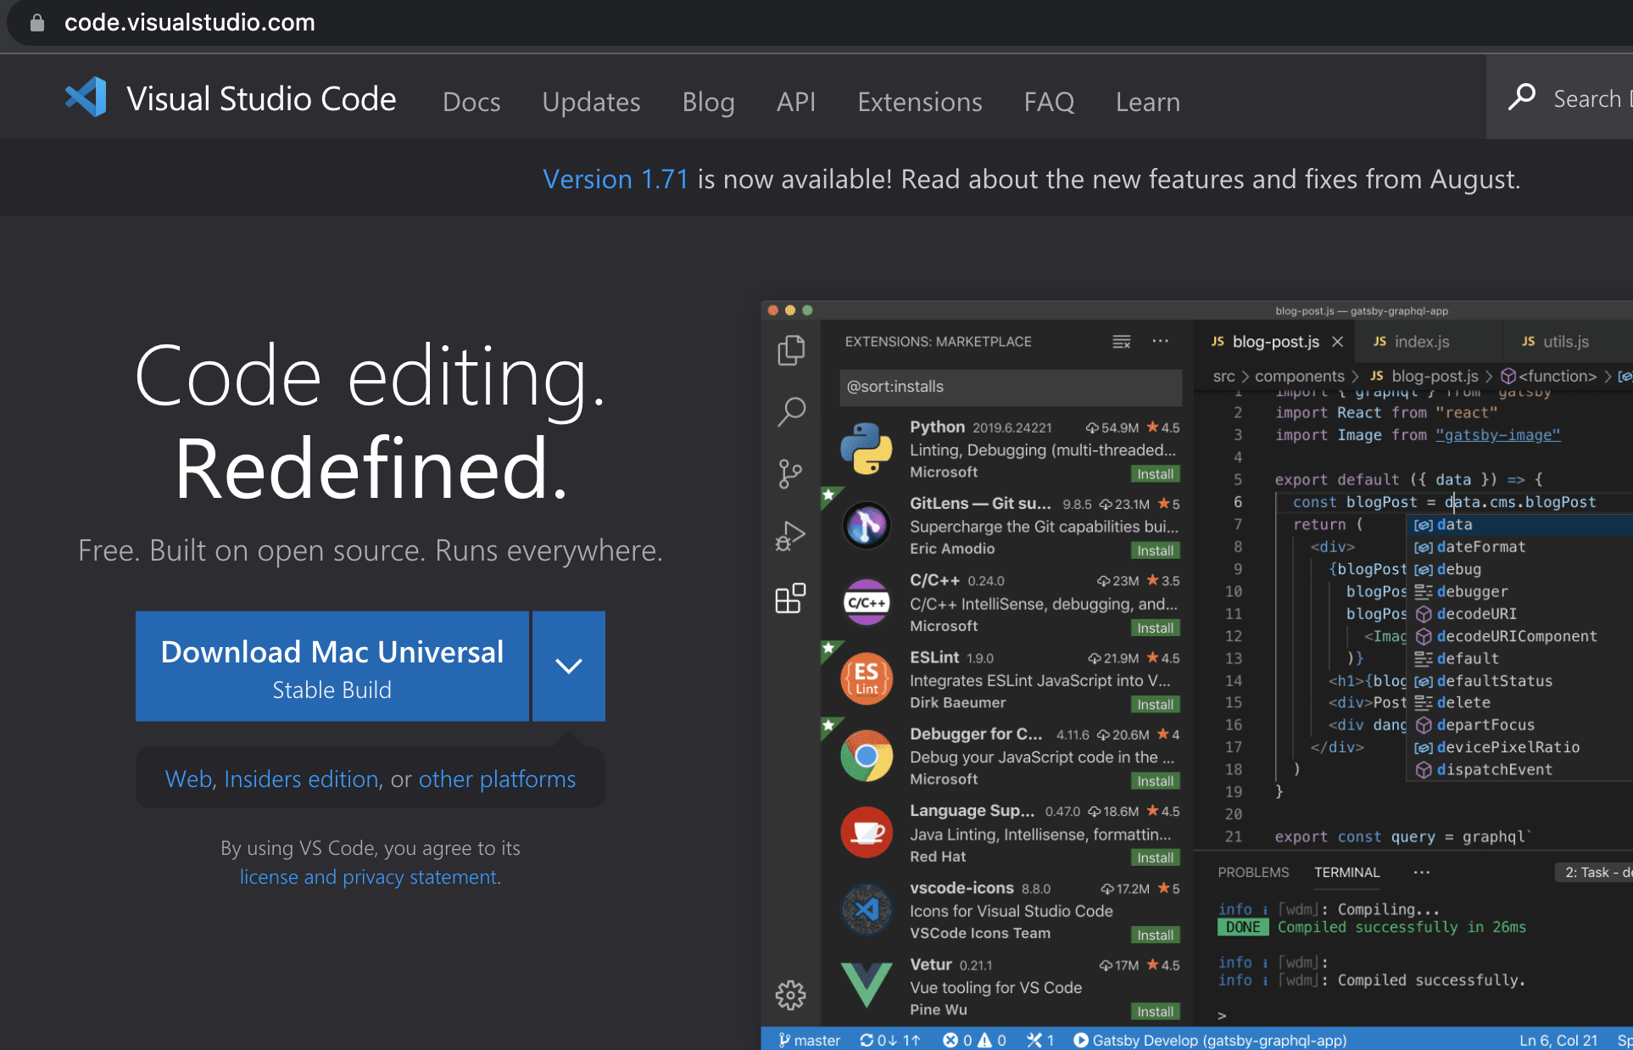
Setting up IDE
Visual Studios Code
Integrated Development Environment
Primary work environment for GO
Extensions needed
Go for Visual Studio Code
GitHub Pull Requests and Issues
Download is available - https://code.visualstudio.com/

Slide 10
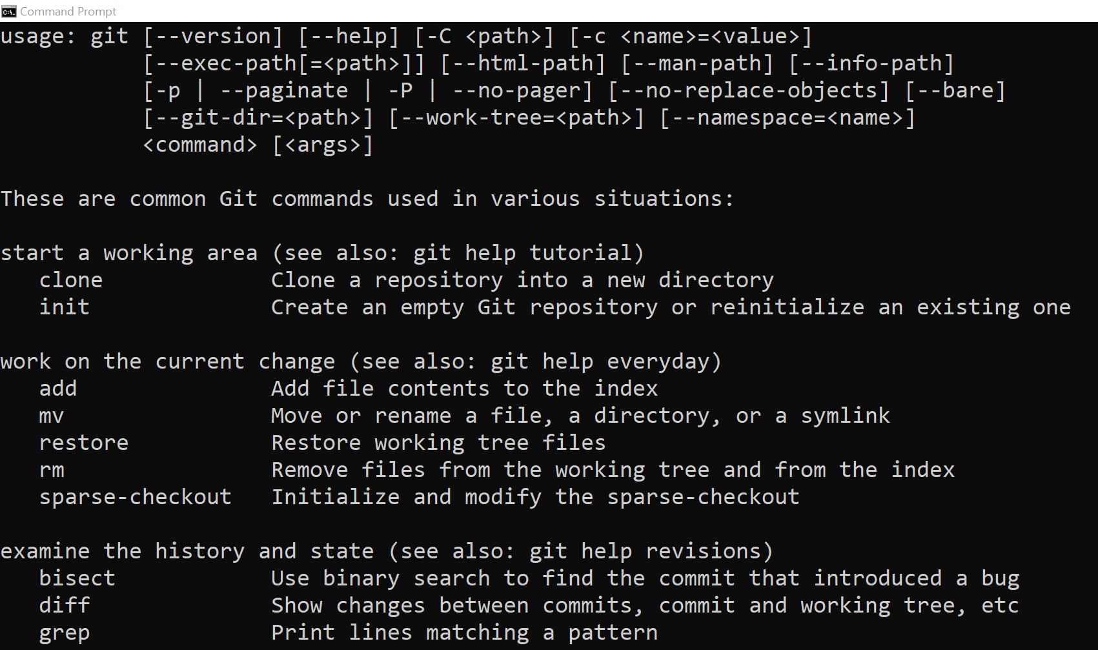
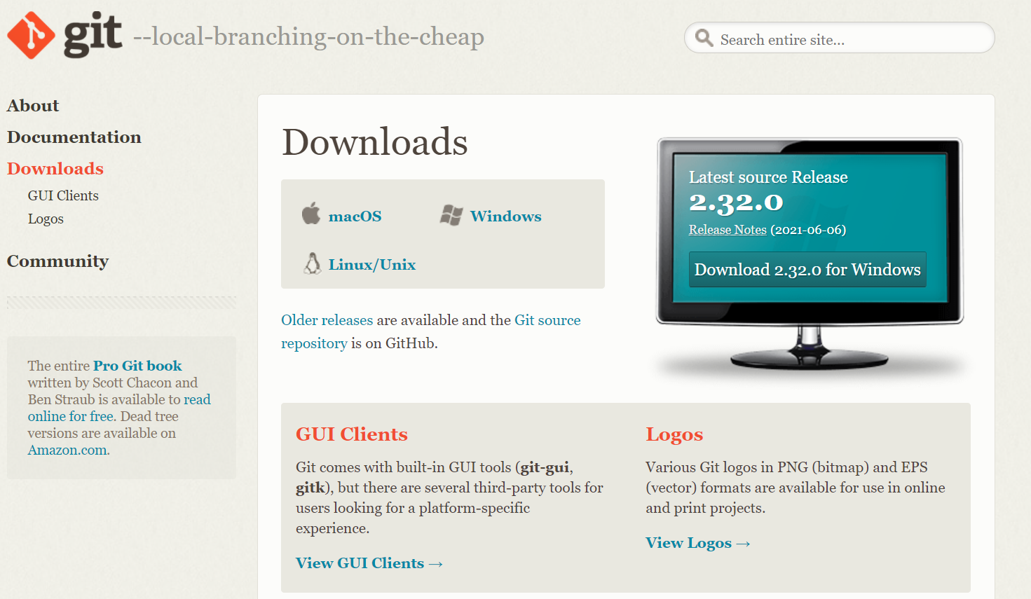
Git Installation
Installation is available online
https://git-scm.com/downloads
Select corresponding version for OS.
After installation
To verify that it is installed using command prompt.
Command: git

Slide 11
Software Versioning Control
Must have for any software development in company.
Simple process to keep track of things.
Long term change history of every file is tracked.
Tracking and storing of project source code.
Earlier and current source code are kept in some form of database.
Allow for easy traverse of different versions of code if needed.

Slide 12
Need for Versioning Control
Concurrent development control
Developer A can develop a feature while Developer B resolves a defect.
Transparency in development team
All information of development from contributors are logged.
Traceability on each change made.
Complement for project management and defect tracking software.

Slide 13
Software Versioning Types
Sequence based
Version number uniquely identifies current state.
Numbered in running order.
Change significance (Go versioning)
Version number identifies the severity of changes done.
Allows for compatibility versioning.
Version number 2.2.1 and 2.4.3 are backward compatible, 3.1.5 is not.
01, 02, 03, 04, 05, …
Running Sequence
X.Y.Z
Major
Internal/ Patches
Minor

Slide 14
Git and GitHub
GitHub
American Company, started in San Francisco.
Provides hosting for software development version control using Git
Subsidiary of Microsoft since 2018 after being acquired for USD 7.5 billion
Responsible for
Atom, free and open-source text and source code editor.
Electron, an open-source framework.

Slide 15
Git and GitHub
Git
Created in 2005
Free and Open-source distributed under GNU General Public License Version 2.
Distributed version control system
Compatible with all operating systems
Tracks changes in source codes.
Allows for non-linear software development.

Slide 16
Importance of Git
Online presence of developers
Primary “bread and butter” for developers
Developer's “Profile” alternative to Facebook, Twitter, Instagrams
Effective way to showcase personal projects
Potential assessment point for potential employers seeking development-based employees.
Compare 10 open-source project commits versus someone with 100 commits to CSS files.

Slide 17
Git
Can be used locally and remotely.
Primarily locally for keeping track of development.
Connect to remote repositories for redundancy or publish purposes.
For local git usage,
https://stackabuse.com/git-create-a-new-repository/
More on Github,
https://docs.github.com/en/github/getting-started-with-github/quickstart/create-a-repo

Slide 18
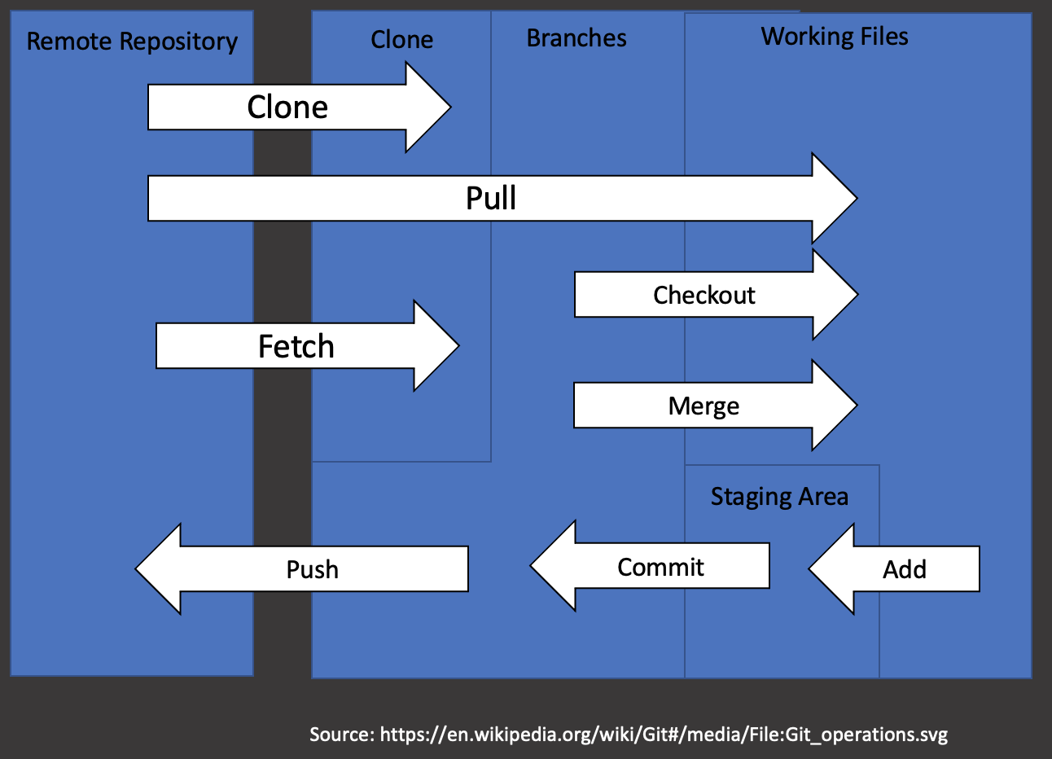
Git
Makes use of two data structures
Staging area (Changeable)
Repository (Append only)

Slide 19
Git Terms
Remote Repository
Main
Clone
Main
Branch
Clone
Creates a copy of the remote repository locally for development
Branch
“Copy” of the working project.
Can be named, listed or deleted with commands.
Head
Last commit of the current checkout branch.
Tag
Specific point of reference made in Git history, usually for release of for stable version or variant of the code intended.
Merge
Merges the branches created back to the main.
Push
Pushes the current local main into the remote repository.
Branch
Head
Merge
Main
Push
Head
Tag
Main
Head
Tag

Slide 20
Git General Flow of Event
In general, Git events during a software development phase includes
Clone
Branch
Checkout
Commit
Checkout
Merge
Pull/ Push
Tag (Typically for Deployment/ Delivery)

Slide 21
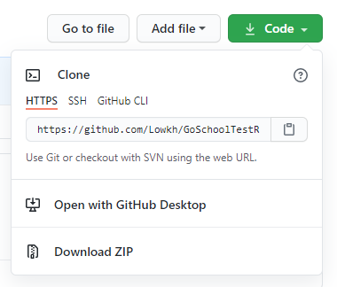
Git Cloning
Creating a local version using git command
“Clone” an exact duplicate into a local folder at the point of execution of the command.
An inner folder will be created based on the name of the repo.
A hidden “.git” folder will be created during the cloning
Contains the information for Git to do its operations.
Removal of this folder will remove the link to the remote repository.
Command
git clone <git url of repository>
<URL of the Repo>

Slide 22
Git Branch
Main
git branch :
List all branches
git branch <name> :
create branches
Branch 1
Branch 2
Branch 3
Create multiple “branch” of the current working project.
Main is actually designated as the “main-branch”
Can be named according to developer/ project needs.
Can also be removed after merging has occurred.
Command:
git branch
git branch <name>
git branch –d <name>
Branch 3
git branch -d <name> : delete branches
Branch 3
Branch 2
Branch 1
Main

Slide 23
Git Branch
Renaming takes a few steps
Change to branch: git checkout <branch name>
Change name: git branch –m <new branch name>
If the branch exists in repo prior to clone, need to update repo of changes
Push to remote to update: git push origin –u <new branch name>
Delete remote old branch: git push origin –delete <old branch name>

Slide 24
Git Checkout
Main
git checkout main
Used to “switch into” desired branch to work on.
Command:
git checkout <branch name>
Branch 1
git checkout Branch 1
Branch 2
git checkout Branch 2

Slide 25
Git Add and Commit
Git tracks all code and files, new files must be added to the list of trackable so that Git can track and record accordingly.
Command: git add .
To commit a confirm snapshot of the current working branch.
Done with meaningful messages to log the commit at the point of time.
Command: git commit –m “message of the commit”
Fully tracked with actor and time of commit.
Possible to delete commits prior to upload but is not advisable
Command: git reset –hard <commit number>
NOTE that this will remove ALL working branch changes.

Slide 26
Git Merge
Main
Git merges from source to destination using the destination branch and combines code together
Merging from branch 1 to the main will take place from main.
Git has to checkout back to the main branch before merging back branch 1 to main branch.
Command: git merge <branch to merge back>
Branch
Branch 1
Merge
Branch 1
Main

Slide 27
Git Pull / Push
Pull is used to get latest update from the remote repository.
Updates current local working branch
Updates remote tracking branches for all branches
Fetches (git fetch) new commits and merges (git merge) into local branches
Command:
git pull
git remote -v (used to check linked remote repo)
git pull origin / git pull upstream (used if multiple remote repos)

Slide 28
Git Tag
Used for releases, tagging a stable version or variant.
Command:
git tag
git tag –a <version number> -m “<tag message>”
git tag show <version number>

Slide 29
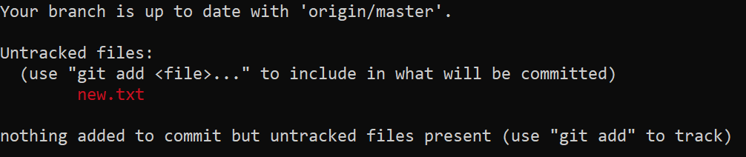
Git Status
Useful command to use to find out information about working directory
Head pointer
Working directory and Staging area condition/ status
Compare remote tracking branch
Suggestions/ Recommendations
Command: git status

Slide 30
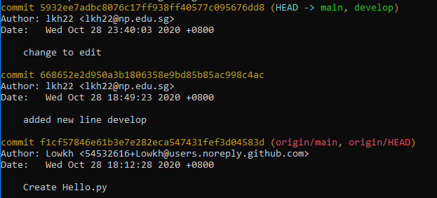
Git Log
Retrieves all current logs available to current working branch.
Contains all commit messages
Author
Date
Time
Commit hash number tag to commit
Command: git log

Slide 31
Git Rebase
Main
Branch
Git rebase compares between different branches and attempts to move both branches to an equal point of commit.
Command: git rebase <reference branch>
Not advisable to be used on public shared repository. Only applicable to local own repository.
Rebasing will cause a change in the main repo which will then cause collaborators to remerge their code base and having to pull back work into the main.
Branch 1
Main 2
Rebase Comparison
Rebase Commit Log
Commit 1
Main 2
Commit 1

Slide 32
Git Overview
Uses four commands to interact with remote repository.
git clone:
Copy repo to a new directory at another location
git fetch:
updates changes from remote repo to main repo. Work branches are not updated
git pull:
Does git fetch + git merge
git push:
Pushes to remote repository
Remote Repository
git pull
git fetch
Working Directory (Branches)
Local Repository
git merge

Slide 33





Typical Git Workflow
Typical single workflow for Git use in solo development, with remote repository.
Clone
Push
Main
Create Branch
Merge Branch
Commits
Test Changes

Slide 34
Go Track Git Workflow
Blend of Git Classroom and Git with automation.
Assessment Automation
Git Classroom Clone
Clone
Push
Output Results
Main
Create Branch
Test Changes
Merge Branch
Commits

Slide 35

Setting up Git Classroom Accounts
Git Classroom Accounts
Primary account for all activities and submission of module assessments.
Simple signup for free account.

Slide 36
Go Program Structure
package main
import (
)
var (
)
func main() {
}
Package name
Import of “libraries”
Declaration of variables
Start of execution
Main program

Slide 37
Go Program Structure
Go uses C++ style comments.
// for single-line comments.
/* … … */ for spanning multiple lines.
Go Packages
Keyword “package”.
Identifies and allows for organisation of related code.
Go Imports
Allows for modular functionalities to be imported as packages.
Keyword “Import”
Every package identified by unique string: import path.
Every package has package name – matches last segment of import path.

Slide 38
Go Program Structure
No semicolons
Semicolons needed only there are multiple on the same line.
Enclosed in braces
{ … your go code goes here … }
Indentation is only for human readability.
Simple package (fmt)
Formatting package.
Allows for different kinds of “print”
Package info: https://golang.org/pkg/fmt/#Println

Slide 39
My First Hello World !
Accept the Git Classroom Link and gain access to the respective Git repositories.
Clone Go “Hello World” and begin working away.

Slide 40
My First Hello World !
package main
Import "fmt"
func printHello() string {
message := "Hello World from Go !!"
fmt.Println(message)
//Do not remove this line
return message
}
func main() {
printHello()
}
Git Assessment Setup
Utilizes on automated testing.
Return is used to yield the outcome.
2
3
1

Slide 41
Go Resources
Let’s try to code and run simple Go applications on the web browser:
Go Playground at https://play.golang.org.
Convenient for performing simple experiments to check understanding at the beginning.
Its persistent URLs allow sharing of snippets of Go code with other people, for reporting bugs or making suggestions.

Slide 42
Go Resources
Documentation on Go
https://go.dev/doc/
Go Packages and its intended usage
https://pkg.go.dev/

Slide 43
Resources
Understanding the GitHub flow
https://guides.github.com/pdfs/githubflow-online.pdf
Git: Create a new repository
https://stackabuse.com/git-create-a-new-repository
GitHub Documents
https://docs.github.com/en
Git Basics – Tagging
https://git-scm.com/book/en/v2/Git-Basics-Tagging

Slide 44
Learning Objectives – Mod 2
At the end of the course, participants should be able to:
Define the commands used in the development of Go.
Define the basic layout of a Go Application.
Create a basic Go Application.
Demonstrate the use of identifiers, packages and dependencies.

Slide 45
Basic Go Commands
Dependencies tracking for Go
Uses go.mod file.
Used to manage dependencies.
Command to enable dependency tracking
go mod init <module path>
Module path
<project name>/<module name>
Retain checksums necessary and remove unnecessary records in go.mod in current working directory
go mod tidy

Slide 46
Go Module, go.mod & go.sum
A collection of Go packages in a folder with go.mod file at folder root.
go.mod contains certain dependency requirements and module path.
go.sum contains the checksum of each dependency identified to be in the module.

Slide 47
go.mod
Contains some keywords
module <name>
indicates name of module.
go <version>
indicates the version of go.
require <module-path + version>
Dependencies required for the module.
replace <module-path + version>
Dependencies locally available and replace.
exclude <module-path + version>
Dependencies to be excluded.

Slide 48
go.sum
Contains checksums of the dependencies
module-path, version and a checksum.
Used as a form of security check when Go downloads missing dependencies or does checks against what is remotely available.
Currently installed module vs proxy server
Typically, not tempered with by developer and left to Go to handle the contents.

Slide 49
Basic Go Commands
Basic dependency control
go get
go get will only switch the version of dependency based on go.mod.
go install
go install will install latest version of dependency needed

Slide 50
Basic Go Commands
Compile and run
go run <filename>
Runs the written application based on filename.
go build
Compiles the packages along with dependencies needed but does not install, result will be an executable program.
./<filename>
<filename>.exe

Slide 51
Versioning in Go
Module path versioning
Use of different folders in development with version V# and respective go.mod files.
main path
go.mod
module.go
v2
go.mod
module.go

Slide 52
Versioning in Go
Branch versioning
Use of branching methods to store different versions of the code. E.g. Git branching
On release, the version is tagged to the module path and only the developed version is taken and used in go.mod and installed accordingly
<module-path>/v2

Slide 53
Recall Go Program Structure
package main
import (
)
var (
)
func main() {
}
Package name
Import of “libraries”
Declaration of variables
Start of execution
Main program

Slide 54
Go Identifiers
Go developers use camelCase when forming names, i.e. interior capital letters over interior underscores
e.g. parseRequestLine, findMaximum
Not wise to create an identifier same as predefined identifier of Go.
Case- sensitive.
Visibility outside a package depends on first letter of the identifier.
Begins with a capital letter => exported, i.e. visible and accessible outside package.
Otherwise unexported, ie. Only visible and assessable by files within package
Cannot be keyword of Go.

Slide 55
Go Identifiers
Nonempty sequence of letters and digits.
Letter
Consists of underscore (“_”)
Unicode categories “Lu”, “Ll”, “Lt”, “Lm”, “Lo”
Alphabetic characters
Digit
Any character in Unicode “Nd”
First character
A letter
Not a name of keyword
Category | Description
Lu | Letter, Uppercase
Ll | Letter, Lowercase
Lt | Letter, Titlecase
Lm | Letter, Modifier
Lo | Letter, Other

Slide 56
Go Keywords
break | default | func | interface | select
case | defer | go | map | struct
chan | else | goto | package | switch
const | fallthrough | if | range | type
continue | for | import | return | var

Slide 57
Predefined Identifier In Go
append | complex128 | imag | len | real | uint16
bool | copy | int | make | recover | uint32
byte | delete | int8 | new | rune | uint64
cap | error | int16 | nil | string | uintptr
close | false | int32 | panic | true
complex | float32 | int64 | print | uint
complex64 | float64 | iota | println | uint8
Source: https://golang.org/ref/spec

Slide 58
Blank Identifier
Serves as a placeholder in Go, where a return value is expected but discarded.
Not considered as a new variable.
count, err = fmt.Println(x) // get number of bytes printed and error count , _ = fmt.Println(x) // get number of bytes printed; discard error fmt.Println(x) // ignore returned values

Slide 59
Go Packages
Used to group similar, related code
Identifiers in packages accessed via “package.identifier”
Supports modularity, encapsulation, reusability
List of Go packages: https://golang.org/pkg/
Scope of packages
There is control over accessiblity of Identifiers outside packages.
Uppercase: identifiers are exported, i.e. visible outside package
Lowercase: are unexported, i.e. not visible outside package

Slide 60
Simple Package Example
Math package functions
math.Abs(x) |x| absolute value of x.
math.Mod(x, y) remainder of x / y.
math.Cos(x) cosine of x in radians.
math.Sin(x) sine of x in radians.
math.Tan(x) tangent of x in radians
math.Ceil(x) the smallest integer greater than or equal to x.
math.Floor(x) the largest integer less than or equal to x.
math.Max(x, y) the larger of x and y.
math.Min(x, y) the smaller of x and y.
math.Pi π constant; approx. 3.141592653589793
math.Sqrt(x) square root of x.
More functions available at https://golang.org/pkg/math/

Slide 61
Simple Package Example
package main import ( "fmt" "math" ) func main() { q := 34.0 r := 8.0 s := math.Mod(q, r) fmt.Println(s) } >>>2
import format package
import math package
math.<function>
fmt.<function>

Slide 62
The “fmt” package
Implements formatted I/O with functions
For printing,
Prints to standard out (console)
Print
Printf
Println
Prints to a string to assign to a variable
Sprint
Springf
Sprintln
Prints to file or web server
Fprint
Fprintf
Fprintln

Slide 63
The “fmt” package
Syntax | Description
%v | value in default format
%#v | value (Go-syntax)
%T | type of value (Go-syntax)
%t | true or false word
%b | base 2
%d | base 10
%x | base 16 lowercase a-f; %#x hexadecimal with “0x”
%f | decimal
%g | floating point values (compact)
%f | floating point, but no exponent
%e | Floating point, scientific notation
Verbs used in printing syntax for “fmt” package.

Slide 64
Learning Objectives – Mod 3
At the end of the course, participants should be able to:
Describe the different data types in primitive data types.
Identify the uses of each data types in the primitive set.
Identify the basic syntax of a basic error handling.

Slide 65
Data Types
Consists of two types
Primitive data types
data type provided as a basic building block for programming language
int8 int16 int32 int64 uint8 … int uint, uintptr, byte, bool, string, rune, float32 float64 complex64 complex128
Composite data type
Also known as compound data type
constructed using primitive data types and other composite types.

Slide 66
Type
Keyword “type”
Go predeclare certain types. e.g. boolean, int, float32 etc.
Customised types binds the identifier to the type using type declaration
Composite types are declared via type literals
Each type has an underlying type
If the underlying type is one of the predeclared type, then the type is the type itself.
Otherwise, it is referred to the type declaration.
A1, A2, B1 and B2 are string.
B3 and B4 are [ ]B1.
type ( A1 = string A2 = A1 ) type ( B1 string B2 B1 B3 [ ] B1 B4 B3 )

Slide 67
Primitive Data Types
Boolean
String
Numeric
Error

Slide 68
Boolean
Boolean
true or false.
No implicit conversion from Boolean value to a numeric value like 0 or 1, or vice versa.
Need to use explicit if to check.
Supported in all standard logical and comparison operations that returns a boolean result.
Typically used in if statements, conditions in for statements and sometimes in conditions for switch statements.
b := true i := 0 if b { i = 1 }

Slide 69
Numeric
Numeric
Type integers and rationals.
Limited by memory of machine.
Distinct type, differently typed values cannot be operated upon.
Untyped numeric constants are compatible with any typed number.
Conversion is needed between different typed values.

Slide 70
Numeric
Go Integer types and ranges
int8 [-128, 127]
int16 [-32768, 32767]
int32 [-2147483648, 2147483647]
int64 [-9223372036854775808, 9223372036854775807]
byte uint8
uint8 [0, 255]
uint16 [0, 65535]
uint32 [0, 4294967295]
uint64 [0, 18446744073709551615]
uintptr unsigned integer storing pointer value

Slide 71
Numeric
Signed vs Unsigned
Binary | Decimal
0000 | 0
0001 | 1
0010 | 2
0011 | 3
0100 | 4
0101 | 5
0110 | 6
0111 | 7
1000 | 8
Binary | Decimal
0100 | 4
0011 | 3
0010 | 2
0001 | 1
0000 | 0
1111 | -1
1110 | -2
1101 | -3
1100 | -4

Slide 72
Numeric
Go floating-point types and ranges
float32 ±3.40282346638528859811704183484516925440 x 10³⁸
float64 ±1.797693134862315708145274237317043567981 x 10³⁰⁸
complex64 The real and imaginary parts of type float32
complex128 The real and imaginary parts of type float64
float64 is preferred for most purposes, because float32 computations can accumulate error rapidly
Very small or large numbers are better written in scientific notation, with letter e or E preceding the decimal exponent.
const Planck = 6.6206957e-24;const Avogadro = 6.02214129e23

Slide 73
String
A sequence of characters with a definite length to represent text.
Immutable sequence of individual bytes, 1 byte per character,
s[0] = "L" //compile error
UTF-8 Unicode encoded.
Double quotes for interpreted string literals. "UTF-8 string", "Hello, 世界\n"
Single quotes for raw string literals (so no escape sequences). `raw string`
Immutable sequence of bytes. s[0] = "L" /compile error
So `\t\.xyz\n` is the same as "\\t\\.xyz\\n"
`”` is the same as "\""

Slide 74
Error Basics
Built-in package to manipulate errors.
Zero value “nil” is used to indicate that there is no error.
Most common way using error type containing last known value
Uses “if” conditional to check return condition.

Slide 75
Learning Objectives – Mod 4
At the end of the course, participants should be able to:
Describe the use of enumerations, constants and declarations.
State the different operators available in Go.
Identify the different types of logic and comparison syntax available.

Slide 76
Enumeration
Used to assign names to numerical constants for ease of reading and maintainability.
Applicable to const, import and var to do group declarations.
Applies to iota as well.
const ( Weight = 44 Height = 165 Age = 22 ) | var ( Weight int Height int Age int ) | import ( “fmt” “os” “reflection” )
const ( position0 = iota position1 position2 )

Slide 77
Constant and Variable Declaration
Values known to the compiler and evaluation guaranteed at compile time.
Fixed values
Declared by “const” keyword.
Can only be char, string, bool or numeric value
Cannot be declared using :=
Untyped Constants Declaration | Typed Constants Declaration
const Pi = 3.14 const( BadRequest = 400 Unauthorized = 401 Forbidden = 403 NotFound = 404 InternalServerError = 500 ) | const Pi float32 = 3.14 const( BadRequest int = 400 Unauthorized int = 401 Forbidden int = 403 NotFound int = 404 InternalServerError int = 500 )

Slide 78
Constant and Variable Declaration
const noDelay time.Duration = 0 const pi = 3.412 const( xmin, ymin, xmax, ymax = -2, -2, +2, +2 width, height = 1024, 1024 )
const ( position0 = iota position1 position2 )
Constant generator iota
Creates a sequence of related values, without specifying value explicitly for each of them.
Starts from 0.
Assign incremental values to variables.
Will reset at next “const”.

Slide 79
Constant and Variable Declaration
Variables
Declared by “var” keyword. var name type = expression
Cannot redeclare variables.
ALL variables must be used.
Go can infer the type of the declared type
Either the type or = expression may be omitted.
If expression omitted, initialized to zero value for that data type (bool: false, numeric types: 0, string: empty string)
Specifying the type
Also legal to specify the type.
Change how Go would normally infer the type.
Declaration
var a = ‘initial’
var i, j, k int
var num1, num2 int = 1, 2
var num3, num4 = 1, 2
var isPositive = true
var xPtr, yPtr *float
var x, y, z = 0, 4.22, false
f := ‘apple’

Slide 80
Constant and Variable Declaration
Short Variable Declaration
name := expression
Usually used to declare local variables.
Type is that of the expression.
:= not the same as =
E.g. x , y, z := 0, 1.23, false // y will be a float64
If one of the variables is declared before, then := will be assignment
At least one of the variables (x, or y or z for e.g.) must not be declared beforehand.

Slide 81
Operators
Mostly C-like operators
Also uses sensible rules of precedence but parentheses ( ) are still advised to avoid mistakes.
Binary operators of same precedence associate from left to right.
x / y * z is the same as (x / y) * z

Slide 82
Operators
Precedence Table
Highest precedence starting with multiplication
Lowest precedence with ||
Operators
* / % << >> & &^
+ - | ^
== != < <= > >=
&&
||
increasing precedence

Slide 83
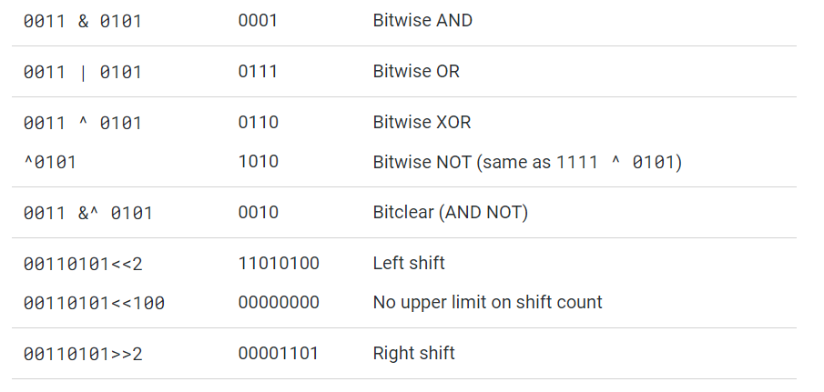
Operators
https://yourbasic.org/golang/bitwise-operator-cheat-sheet/

Slide 84
Operators
Assignment operator
name1 = name2
Multiple assignment works.
Functions can return multiple values.
Unwanted values can be assigned to blank identifiers.
x, y, z = f1(), f2(), f3() a, b = b, a //swap works too
links, err := findLinks(url)
_, err = io.Copy(a, b) //discard byte count count, err = fmt.Println(x) count , _ = fmt.Println(x)

Slide 85
Operators
Assignment operator
+=, -=, *= and /= assignment operators still work.
Increment and decrement via ++ and -- still valid.
In Go increment and decrement operations can’t be used as expressions, only as statements.
Also, only the postfix notation is allowed.
x = 2 x += 2 //x becomes 4//x = x+ 2
x = 2 x++// x becomes 3 x--//x becomes 2

Slide 86
Operators
Assignment operator with new keyword
new keyword allocates memory for object.
Similar to function call, with type of object as argument, similar to C++
Returns reference to object.
Go has Garbage Collection.
var p *Contact = new(Contact) v := new(int) // v has type *int

Slide 87
Operators
Arithmetic operators are applicable to all numeric types.
Generated result is of same type as the first operand.
Standard arithmetic operators (+, -, *, /) apply to integer, floating-point, and complex types.
+ also applicable to strings (string concatenation)
bitwise logical and shift operators only apply to integers.

Slide 88
Operators
x % y remainder of dividing x by y.
x & y bitwise of x AND y.
x | y bitwise of x OR y.
x ^ y bitwise of x XOR y.
x %= y x assigned remainder of dividing x by y.
x &= y x assigned result of x AND y bitwise.
x |= y x assigned result of x OR y bitwise.
x ^= y x assigned result of x XOR y bitwise.
x &^= y x assigned result of x AND NOT y.
x << n left-shifting of x by unsigned int n.
x >> n right-shifting of x by unsigned int n.

Slide 89
Operators
+ | & | += | && | == | != | ( | )
- | | | -= | || | < | <= | [ | ]
* | ^ | *= | <- | > | >= | { | }
/ | << | /= | ++ | = | := | , | ;
% | >> | %= | -- | ! | ... | . | :
 | &^
Source: https://golang.org/ref/spec

Slide 90
Logic and Comparison
Logical operators
"||” (logical OR) and “&&” (logical AND)
Evaluates between both sides of the operator and returns a Boolean result.
Comparison operators
<, <=, ==, !=, >=, >
Both sides of the operator must the same type or of same interface type.
Would require explicit type conversion, if different types are used for either side.

Slide 91
Logic and Comparison
Truth Table
Condition A | Condition B | A || B | A && B | Not A
False | False | False | False | True
False | True | True | False | True
True | False | True | False | False
True | True | True | True | False

Slide 92
Logic and Comparison
Comparison Operation | Result
! A | Logical NOT operator, False if A is True
A || B | True if either A or B is True
A && B | True if both A and B are True
A < B | True if A is less than B and False if not.
A <= B | True if A is less than or equal to B and False if not.
A == B | True if A is equal to B.

Slide 93
More on Strings
Use bracket operators to access the contents of the string.
Space is considered a character in string.
There is no negative index.
Characters | ‘G’ | ‘o’ |  | ‘S’ | ‘c’ | ‘h’ | ‘o’ | ‘o’ | ‘l’
Bytes | 0x47 | 0x6F | 0x20 | 0x53 | 0x63 | 0x68 | 0x6F | 0x6F | 0x6C
Position | 0 | 1 | 2 | 3 | 4 | 5 | 6 | 7 | 8
>>>fmt.Println(name[0]) 71 >>>fmt.Println(string(name[0])) G

Slide 94
Slices in String
Use [n:m] operator to access part of the string from position n to m-1
If n is omitted, the slice starts from the beginning of the string.
If m is omitted, the slice goes to the end of the string.
Characters | ‘G’ | ‘o’ |  | ‘S’ | ‘c’ | ‘h’ | ‘o’ | ‘o’ | ‘l’
Bytes | 0x47 | 0x6F | 0x20 | 0x53 | 0x63 | 0x68 | 0x6F | 0x6F | 0x6C
Position | 0 | 1 | 2 | 3 | 4 | 5 | 6 | 7 | 8
>>>fmt.Println(name[1:5]) O Sc >>>fmt.Println(name[:6]) Go Sch >>> fmt.Println(name[4:] chool

Slide 95
Other common string manipulation
Concatenation
Process of adding two or more strings into a new single string.
Uses + operator
package main import ( "fmt" ) func main() { var str1 string = "Welcome" var str2 string = "To Go School" fmt.Println(str1 + " "+ str2) } >>>Welcome To Go School

Slide 96
Other common string manipulation
Append operator
Adds new or given string to the end of the specified string.
package main import ( "fmt" ) func main() { var str1 string = "Welcome" var str2 string = "To Go School" str1 += str2 fmt.Println(str1) } >>>WelcomeTo Go School

Slide 97
Other common string manipulation
Different options available for String Manipulation
s == r compare string s and string r.
s += t appends string t to end of string s.
s + t concatenation of strings s and t.
s[n] index position n in string s.
s[n:m] string taken from s from index n to m-1.
s[n:] string taken from s from index n to len(s) -1.
s[:m] string taken from s from index 0 to m-1.
len(s) the number of bytes in string s
string(i) converts i into string.
Use strconv package for strings conversion.

Slide 98
Learning Objectives – Mod 5
At the end of the course, participants should be able to:
Describe the different data types in composite data types.
Identify the uses of each data types in the composite set.
Identify and Deduce the further uses of strings
Identify and Compare the difference of Arrays and Slices.
Examine the underlying properties of Arrays and Slices.

Slide 99
Composite Types
8 Composite Types
Array
Slice
Struct
Pointer
Map
Channel
Function
Interface

Slide 100
Array
A numbered sequence of elements of the same data type.
Primarily building blocks for Slices.
Mapping of index is integer.
Indexes are non-negative.
Zero based index.
However, in terms of idiomatic Go - Use Slices instead.

Slide 101
Array
Declaration
var <array name> [array length] array_type
var a [10] int
Declaration and Assignment
<array name> := [...] array_type {v1, v2…}
a := [...]int{0, 1, 2, 3}

Slide 102
Array
Assignment by location
<array name> [array index] = element
a[1] = 5
Length of array
len(<array name>)
len(a)
var a [10] int
fmt.Println(“Array: “, a)
a[1] = 5
fmt.Println(“Array: “, a)
fmt.Println(a[1])
>>>Array: [0 0 0 0 0 0 0 0 0 0]
>>>Array: [0 5 0 0 0 0 0 0 0 0]
>>>5

Slide 103
Slice
Abstract and manipulate an underlying array.
Can vary in size dynamically.
Consist of 3 fields
pointer to underlying array,
length (number of elements it can access)
capacity (number of elements it can grow)
array := [...]int{2, 4, 6, 8, 10, 12, 14, 16, 18, 20} slice := array[0:5]
Capacity of slice
2 | 4 | 6 | 8 | 10
12 | 14 | 16 | 18 | 20
Length of slice

Slide 104
Slice
Length of slice can found via the built-in function len.
Elements of the slice is addressed from 0 to len(slice) -1.
Declared using “composite literal” syntax
{ … }
slice := [ ] int {2, 3, 4, 6, 8, 9, 3, 4} fmt.Println(slice) >>> [2 3 4 6 8 9 3 4]

Slide 105
Slice
To create
slice = make( [ ] type, length, capacity )
slice := make( [ ] type, length)
slice := []type { v1, v2…}
new([capacity] type)[0: length]
slice := anotherslice[i:j]
To find length
len(slice)
To find capacity
cap(slice)

Slide 106
Slice
Accessing specific element in a slice
can be accessed using
slice [ location position ]
Slice and looping
Usual 3 component for loop or for range can be used to iterate over slice.
slice : = []int {4,5,6,7,8,9} for i = 0 ; i <=len(slice) - 1; i++{ fmt.Println(i, slice[i]) } | slice : = []int {4,5,6,7,8,9} for i, v := range slice{ fmt.Println(i, v) }

Slide 107
Slice
Slicing a Slice (Sub-slicing)
Allow for access to a portion of the original slice.
Starting position ‘to’ 1 element before ending position.
Slicing need to happen within the capacity limits of the slice.
slicePortion := [ ] type { … … } slicePortion [ n: m ] where n : Starting position m : Ending position

Slide 108
Slice
Copying of Slices
slice := [ ] string{“Hi”, “Welcome!”} cpy := make([ ] string, 3) copy(cpy, slice) fmt.Println(“Copy: ”, cpy) >>> Copy: [Hi Welcome! ]
slice
cpy

Slide 109
Slice
Appending of Slices
slice
slice := [ ] string{“Hi”, “Welcome!”} cpy := make([ ] string, 3) copy(cpy, slice) fmt.Println(“Length before append: ”, len(cpy)) cpy = append(cpy, “This is the first append”) cpy = append(cpy, “This is the second append”) fmt.Println(“Length after 2 append: ”, len(cpy)) >>> Length before append: 3 >>> Length after 2 append: 5
cpy
cpy

Slide 110
Slice
Append beyond capacity
a new capacity is specified that is double of the maximum original capacity is created
current slice is then appended to the original slice in the new capacity
old capacity “array” is then destroyed.
slice := [ ] string{“Hi”, “Welcome!”}
cpy := make([ ] string, 3)
copy(cpy, slice)
fmt.Println(“Capacity before append: ”, cap(cpy))
cpy = append(cpy, “This is the first append”)
cpy = append(cpy, “This is the second append”)
fmt.Println(“Capacity after 2 append: ”, cap(cpy))
>>> Capacity before append: 3
>>> Capacity after 2 append: 6

Slide 111
Slice
Multi-Dimension Slices
also known as 2 dimensional slices
make( [ ] [ ] type, length, capacity )
new( [capacityX] [capacityY] type )[ 0: length ]

Slide 112
Struct
A sequence of named elements called fields.
Each field has a name and type.
Specified explicitly (Identifier List)
Specified implicitly (Anonymous Field)
Each non-blank field name must be unique
type structName1 struct { field1 field1type } type structName2 struct{ structName1 field2 field2type }
Anonymous Field
Identifier List

Slide 113
Struct
Struct Creation
type <struct name> struct { field1 field1type field2 field2type … … … … … }
type student struct{ studentID int studentName string }

Slide 114
Struct
To give value to basic stuct
<struct> := <struct name>{ field1 : content1, field2 : content2, … … … }
student1 := student{ studentID: 12345, studentName: “John”, }

Slide 115
Struct
To create embedded struct
type structName1 struct { field1 field1type } type structName2 struct{ structName1 field2 field2type }
struct1 := structName2{ structName1: structName1{ field1: content, }, field2 : content, }

Slide 116
Struct
Accessing embedded struct
Use of “dot” notation - struct1.field1
Accessing same field when there is a conflict in field naming
struct1.structName1.field1
struct1 := structName2{ structName1: structName1{ field1: content, }, field1 : content, }

Slide 117
Struct
Anonymous Structs
struct declared immediately and used only once
to minimize code pollution. i.e. anonymous structs is only used once in the entire code.
struct1 := struct{ field1 field1type }{ field1: content, }, field1 : content, }

Slide 118
Map
Associate values of one type to another type
indexed using a unique set of keys (key) to unordered group of elements of one type (element)
Offers fast lookups, adds and deletes.
Initialized as ‘nil’
Key type requires comparison operators to be fully defined
cannot be function, map, slice
needs to be dynamic if the key is an interface type

Slide 119
Map
To create
m := make ( map[ string] type , capacity)
To find length
len(m)
goTrack := map[string]int{
“John”: 123,
“Tom”: 234,
“Jerry”: 432,
}
Key | Value
John | 123
Tom | 234
Jerry | 432
length

Slide 120
Map
Accessing the map
<map name> [“ key “] returns the element
Making use of the map ability
two value test
i , ok := <map name> [“key”]
i is the value which will be assigned the retrieved element
ok is true if the key exist in the map and false if it does not.
_, ok := <map name> [“key”]
test the key without retrieving the value mapped to the key.
Key | Value
John | 123
Tom | 234
Jerry | 432
>>>seanID := goTrack[“Sean”] >>>0 >>>seanID, ok := goTrack[“Sean”] >>>0 false

Slide 121
Map
Adding new keys to new elements
<map name>[ “key” ] = element
Key | Value
John | 123
Tom | 234
Jerry | 432
Key | Value
John | 422
Tom | 234
Jerry | 432
Insert “442” @John
goTrack[“John”] = 442

Slide 122
Map
Deleting key and elements from existing map
delete ( <map name>, “ key” )
Key | Value
John | 123
Tom | 234
Jerry | 432
Key | Value
John | 422
Jerry | 432
delete(goTrack, “Tom”)

Slide 123
Map
Display contents of the map
simple print - use fmt.Println(map)
Key | Value
John | 123
Tom | 234
Jerry | 432
fmt.Println(goTrack) >>> map[ Jerry:432 John:123 Tom:234 ]

Slide 124
Map
Deep copy of Maps
originalMap := make(map[string] int) originalMap[“Vegetables”] = 1 originalMap[“Drinks”] = 2 originalMap[“Meat”] = 3 originalMap[“Appliances”] = 4 targetMap := make(map[string] int) for key, value := range originalMap{ targetMap[key] = value } fmt.Println(targetMap) >>> map[ Appliances:4 Drinks:2 Meat:3 Vegetables:1 ]
Create original map
Create target map
For all range of original map, assign from original to target map

Slide 125
Channel
A means of sending and receiving from functions that are concurrently executed (goroutines)
Channels are created as blocking.
Communication is blocked by default until other end is ready to receive.
Direction of sending and receiving can be assigned by “<-” or bidirectional when not defined.
Created using make keyword
make( chan type, buffer length) // Bidirectional
make( chan <- type ) // Send
make( <- chan int ) // Receive

Slide 126
Pointer
A pointer type is the set of all pointers to variables of a given type.
Uninitialized pointer has a value of nil.
Allows for pass by value in the application.
Used to pass address instead of passing entire amount of value.
Used to pass address to be dereferenced to get actual value.
Used to change value at address.

Slide 127
Pointer
Accessing Pointer
use of keyword “&”
“ * int “ - pointer to an int
Dereferencing to a pointer
use of keyword “*”
returns the value at the given address
Address | 0xc00002c008 | 0xc00002c040 | 0xc00002c048
Value | 10 | 12 | 14
a := 12 fmt.Println(a) fmt.Printf(“%T”, a) fmt.Println(&a) fmt.Printf(“%T”, &a) >>>12 >>> int >>> 0xc00002c040 >>> *int

Slide 128
Pointer
Changing of value using address of pointer
Address | 0xc00002c008 | 0xc00002c040 | 0xc00002c048
Value | 10 | 12 | 14
a := 12 b := &a *b = 10 fmt.Println(a) >>>10
a
12 | 0xc00002c040
10
0xc00002c040
b

Slide 129
Learning Objectives – Mod 6
At the end of the course, participants should be able to:
Define the ”IF” conditional control structure.
Examine the different “IF” conditional scenarios.
Apply the “IF” conditional control structure.
Define the “FOR” control structure.
Examine the different “FOR” conditional scenarios.
Apply the “FOR” conditional control structure.

Slide 130
Control Structures
Alters flow of control in programs.
Similar to C syntax
Analyze variables and choose a direction to go in the application
If statements
For statements
Switch statements
Conditional expressions are not enclosed by parenthesis ( ).
But braces { } to encapsulate the control structure block is a must.

Slide 131
IF statements
conditional statement of two code blocks that would execute the respective block of code when the expression for condition evaluates to be true.
Keyword used
“if”
“else if”
“else”
Can be preceded by simple statement which is executed before the conditional expression is evaluated.
There is no ternary conditional operator in Go.
i.e. if a?b: { /* code block */ }

Slide 132
IF statements
IF statements
Evaluate condition as true and execute code block.
Does nothing if evaluated condition is false.
/* … code block before if statement … */ if condition { /*… condition true code block … */ } /* … code block after if statement … */
1
true

Slide 133
IF statements
/* … code block before if statement … */ if condition { /*… condition true code block … */ } else { /*… alternate code block … */ } /* … code block after if statement … */
IF … ELSE statements
Evaluate condition as true and execute code block.
Executes alternate code block if condition is false.
Either one code block would execute.
1
true
2
otherwise

Slide 134
IF statements
/* … code block before if statement … */ if condition { /*… condition true code block … */ } else if condition2 { /*… condition true code block … */ } else { /*… alternate code block … */ } /* … code block after if statement … */
1
true
IF … ELSE IF … ELSE statements
Evaluate condition as true and execute code block and exists from the IF statements.
Evaluate next condition if current condition is false.
Execute alternate code block if all previous conditions are false.
2
true
3
otherwise

Slide 135
IF statements
if <simple statement>; condition { /*… condition true code block … */ } else if condition { /*… condition true code block … */ } else { /*… alternate code block … */ }
if links, err := findLinks(url); err != nil { /*… condition true code block …*/ }
IF statements with declaration prior
Simple statement added prior to expression
Simple statement executed first before expression is evaluated.

Slide 136
IF statements examples
if x < min { min = x } | if x <= y { min = x } else{ min = y } | if x := 0; x < y { return x } else if x > z { return z } else { return y } | if x, y := 0, 2; x < y { return x } else if x > z { return z } else { return y }

Slide 137
FOR statements
Go FOR loops unifies “for” and “while” loops and has no “do-while” loops
FOR statements exist in 3 forms
Single condition
A “for” clause
A “range” clause

Slide 138
FOR statements
FOR clause consist of
Init value
Condition
Post statement
Init statement may be specified if needed
Post statement may be specified if needed
Must not be short variable declaration
Init statement is executed once before evaluating the condition if it is not empty.
Post statement is executed if and only if the code block is executed.
1
2
4
for init statement; condition; post statement{ /*… code block … */ }
3

Slide 139
FOR statements
Syntax for look in C applies
Multiple variables can be initialized with values in the init statement.
result := 1 for i := 1; i < 5; i++{ result *= i } fmt.Println(result)
for i, j := 0, N; i < j; i, j = i + 1, j - 1 { /* …code block… */ }

Slide 140
FOR statements
Single conditional form
Simplest form of FOR statements.
Code block executes repeatedly as long as Boolean conditional expression is evaluated to be true.
Boolean value is always evaluated to true if no condition is provided.
Code block is repeatedly executed.
FOR statement becomes a while “true” loop.
for condition { /* …code block … */ }

Slide 141
FOR statements
result := 1 i := 1 for i < 5 { result *= i i++ } fmt.Println(result)
No init, post statements, like “while” loop.
No init, condition and post, like “while” true.
result := 1 i := 1 for { if i >= 5 { break } result *= i i++ } fmt.Println(result)

Slide 142
FOR statements
“FOR range” syntax
iterates all entries of
Array
Slice
String
Map
Values received on a channel.
assigns iteration values to corresponding iteration variables if present in code block and then executes the code block.
Is given in syntax of
for expressionList = range expression { /*…code block … */ }
for identiferList := range expression { /* code block … */ }
One or two possible returned values depending on the type of the expression.

Slide 143
FOR statements
FOR range clause returned values versus type of expression
Expression | 1st Value | 2nd Value
array or slice | index | value at index
string | index | value^
map | key | value at key
channel | element | Not applicable
^ for string, “range” iterates over the Unicode code points in the string starting at byte index 0. Unicode code uses 1 to 4 bytes to show languages. If an invalid sequence is found, a value of 0xFFFD ( “?” symbol ) will be displayed instead.

Slide 144
FOR statements
String example
Map example
Slice example
names := []string{“Anna", “John"}
for _, s := range names {
fmt.Println(s)
}
kvs := map[string]string{"a": "apple", "b": "banana"}
for k, v := range kvs {
fmt.Printf("%s -> %s\n", k, v)
}
nums := []int{2, 3, 4}
sum := 0
for _, num := range nums {
sum += num
}
fmt.Println("sum:", sum)

Slide 145
FOR statements
Nested loop
One FOR loop in another FOR loop.
The inner loop is evaluated first on each iteration of the outer loop.
Once the final iteration of the inner loop is completed the outer loop is then evaluated.
for init statement; condition; post statement{ for init statement; condition; post statement{ /*…code block … */ } }
1
2
3

Slide 146
FOR statements
Break
Terminate execution of the current loop.
Paired with conditional IF statement.
for i := 0; i < 10; i++{ if i == 5{ fmt.Println(“Breaking out of the loop!”) break // break out here } fmt.Println(“The value of i is” , i) }

Slide 147
FOR statements
Continue
Skip the remaining statements in the loop and restart a fresh new iteration.
Paired with conditional IF statement
for i := 1; i < 10; i++ { if i % 2 == 0 { // skip even numbers continue } fmt.Println(i) }

Slide 148
Switch
Runs the first case equal to the condition expression.
Case evaluation from top to bottom.
Fallthrough is not default, break is not needed.
Uses the “switch, case, default” style.
If no case matches, statements in default execute.
Cases need not be in constants or integers.
Cases can be for expression switches or type switches.
Multiple cases are separated by ,

Slide 149

Switch
switch simple statement; expression { case 1: /*… code block … */ case 2: /*… code block … */ default: /*… code block … */ }
Expression Switch
Evaluated left to right, top to bottom.
Possible to precede the switch expression with a simple statement.
Simple statement executed first before the expression is evaluated.

Slide 150
Switch
switch ch := "b"; ch { case "a": fmt.Println("a") case "b", "c": fmt.Println("b or c") default: fmt.Println("No matching character") }
Example
Preceding statement before switch statements

Slide 151
Switch
switch expression { case condition: /*… code block … */ case expression: /*… code block … */ default: /*… code block … */ }
Expression cases
Cases can be expressions or conditions that are evaluated.

Slide 152
Switch
char := "a" switch char { case "a": fmt.Println("a") case "b": fmt.Println("b") default: fmt.Println("No matching character") }
Example
Char has been assigned a value and compared in switch statement
char := "a" switch { case char == "a": fmt.Println("a") case char == "b": fmt.Println("b") default: fmt.Println("No matching character") }

Slide 153
Switch
switch expression { case condition1, condition 2: /*… code block … */ fallthrough case condition 3: /*… code block … */ case condition 4: /*… code block … */ default: /*… code block … */ }
Multiple cases
Multiple cases with same code block can be used.
Fallthrough
Evaluate the following case as true, force the execution flow to fall through the successive case block.
1
Condition 3 is always true if 1 / 2 are true.

Slide 154
Switch
package main
import (
"fmt"
"time"
)
func main() {
today := time.Now()
switch today.Day() {
case 5:
fmt.Println("Clean your house.")
fallthrough
case 13:
fmt.Println("Buy some wine.")
fallthrough
case 15:
fmt.Println("Visit a doctor.")
fallthrough
case 25:
fmt.Println("Buy some food.")
fallthrough
case 31:
fmt.Println("Party tonight.")
default:
fmt.Println("No information available for that day.")
}
}
Output?

Slide 155
Switch
Type switch
Used to assert and respond accordingly to type of variables.
Use of keyword “type”
var x interface{ } // to learn later switch x.(type) { case bool: /*… code block … */ case int: /*… code block … */ case customisedType: /*… code block … */ default: /*… code block … */ }

Slide 156
Switch
var x interface{}
switch q := x.(type) {
case bool:
fmt.Println("value is of boolean type")
case float64:
fmt.Println("value is of float64 type")
case int:
fmt.Println("value is of int type")
default:
fmt.Printf("value is of type: %T", q)
}
Example using Type

